Slide 1
Lecture 30 – Hashing
CST370 – Design & Analysis of Algorithms
Dr. Byun
Computer Science

Slide 2
Lecture Objectives
After completion of this lecture, you will be able to
  explain the basic idea of hash function and hash table.
  recognize the difference between open hashing and closed hashing to avoid collision.

Slide 3
Chapter 7: Space and Time Trade-Offs
7.1 Sorting by Counting
7.2 Input Enhancement in String Matching
7.3 Hashing
7.4 B-Trees

Slide 4
Dictionary in CS
A dictionary (or an associative array, a map, or a symbol table) is an abstract data type composed of a collection of (key and value) pairs.
  Each key should be unique.
Example
  Student ID (= key) and his/her academic record (= value).
  Bank account number (= key) and associated customer’s information (= value).

Slide 5
Operations of Dictionary
Three major operations of a dictionary
  Searching
  Insertion
  Deletion
Implementation of dictionary
  Sorted array?
  Balanced binary search tree?
  etc.

Slide 6
Introduction to Hashing
Hashing is an efficient way to implement a dictionary.
  Pre-structuring of data for faster access of data with extra space.

Slide 7
Hashing – Example (1 of 2)
Watch this video first
  https://youtu.be/geX6x33fKzY (3:56)
Assume that you want to keep the id numbers of students in a class.
  The numbers are in the range of 0 to 9999.
Main operations you want to do are
  Search an id number.
  Insert a new id number.
  Delete an id number.

Slide 8
Hashing – Example (2 of 2)
Insert two numbers 1234 and 2000.
index
content
0
1
…
34
…
99
Sample Hash Table

Slide 9
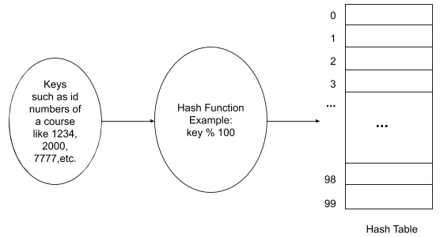
Hash Table and Hash Function for Hashing

Slide 10
<<< Course Instruction >>>
Read the following google document to get the basic concept of hashing.
  https://bit.ly/376UzX0
  Note that there are two approaches to deal with the collision in a hash table named separate chaining and linear probing.

Slide 11
Requirements of a Hash Function
A hash function should
  be easy to compute.
  distribute keys as evenly as possible.

Slide 12
Collisions (1 of 2)
If h(k1) = h(k2), there is a collision.
Example
  ID 1234 vs ID 2234
  ID 2000 vs ID 7000

Slide 13
Collisions (2 of 2)
Separate chaining (or we call it open hashing or closed addressing)
  Each cell of a hash table is a header of linked list of all keys hashed to it.
Open addressing (or we call it closed hashing)
  If collision happens, find another cell by either linear probing or double hashing (use second hash function).

Slide 14
Separate Chaining – Example (1 of 2)
Hash function
  h(k) = (sum of letter positions in alphabet) % 13
Sample words
  h(“A”) = 1
  h(“FOOL”) = (6 + 15 + 15 + 12) % 13 = 9
  h(“ARE”) = 11
  h(“SOON”) = 11
  h(“PARTED”) = 12
Q: What is the hash table size?

Slide 15

Separate Chaining – Example (2 of 2)
h(“A”) = 1
h(“FOOL”) = 9
h(“ARE”) = 11
h(“SOON”) = 11
h(“PARTED”) = 12

Slide 16
Exercise
Assume that you have following key values and a hash function.
  Keys: 30, 14, 17, 25, 45.
  Hash function: h(key) = key % 7
Draw a hash table which uses the separate chaining after inserting all key values.

Slide 17
Solution – Separate Chaining
Size of hash table: “7”
Hash function result
  h(30) = 2
  h(14) = 0
  h(17) = 3
  h(25) = 4
  h(45) = 3
“45” collides with “17”.
  You can append “45” at the end.
  Or you can insert it at the front.
0
14
1
2
30
3
17
45
4
25
5
6
Hash Table

Slide 18
Load Factor in a Hash Table
If a hash function evenly distributes n keys to a hash table with size m, each index (or bucket) has about n/m keys.
We call n/m the load factor of a hash table.
  Load factor is tightly related to the efficiency of hashing.

Slide 19
Load Factor – Example
Number of keys: 100
Hash table size: 50
Load factor: 2 (= 100/50)
  So, we can assume that there will be about 2 keys in each index, if our hash function evenly distributes the keys to the hash table.

Slide 20
Separate Chaining – Analysis
Load factor is typically kept small such as 1 or less.
  The load factor of Java HashMap is about 0.75.
If n is the about same size of m (i.e., n = m), the average time complexities for searching, insertion, and deletion operations are Θ(1).

Slide 21
Puzzle
Assume that there is a book which is numbered from the page 1.
  If the number of digits used in the book’s pages is 1,578, what is the last page of the book?
Pay attention to the “number of digits”.
  For example, the page number “9” is composed of just one digit of ‘9’.
  Similarly, the page number “75” is composed of two digits of ‘7’ and ‘5’.

Slide 22
Solution

Slide 23
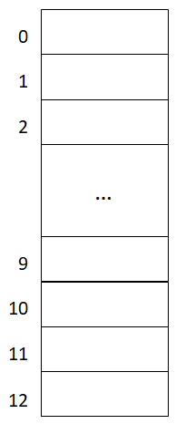
Linear Probing – Example
h(“A”) = 1
h(“FOOL”) = 9
h(“ARE”) = 11
h(“SOON”) = 11
h(“PARTED”) = 12

Slide 24
Exercise
Assume that you have following key values and a hash function.
  Keys: 30, 14, 17, 25, 45.
  Hash function: h(key) = key % 7
Draw a hash table which uses the linear probing after inserting all key values.

Slide 25
Solution – Linear Probing
Size of hash table: “7”
Hash function result
  h(30) = 2
  h(14) = 0
  h(17) = 3
  h(25) = 4
  h(45) = 3
“45” collides with “17”.
  So, it’s inserted to the next available entry, which is the index 5.
0
14
1
2
30
3
17
4
25
5
45
6
Hash Table

Slide 26
Linear Probing – Analysis
If n (= number of keys) is bigger than m (= table size), the linear probing doesn’t work.
  Generally, the load factor in the linear probing should be below 0.5.
Deletion is not straightforward.
  “Lazy deletion”.

Slide 27
Lazy Deletion
Each entry of a hash table keeps its state of “empty”, “active” or “deleted”.
When the hash table starts, all entries have “empty” states.
  For an insertion, its state becomes “active”.
Deletions are done by marking an entry as “deleted”.
  Deleted entries are treated as empty when inserting and as occupied during a search.

Slide 28
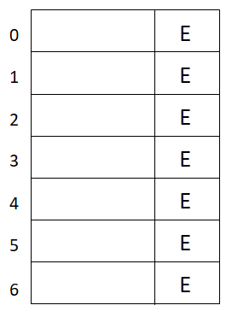
Lazy Deletion – Example
h(key) = key % 7
Insert 9
Insert 16
Delete 9
Search 16
Insert 23

Slide 29
Lazy Deletion – Disadvantage
A problem of lazy deletion, or linear probing in general, is that as the number of delete/insert operations increases, the cost of a successful search increases.
  We may have a big cluster in the hash table.

Slide 30
Rehashing
If the load factor is greater than its pre-defined value (= for example, 0.5 in the linear probing and 0.75 in the separate chaining),
  We find the first prime that is twice as large as the old table size.
  Then, traverse the old table and insert the valid data to the new table.

Slide 31
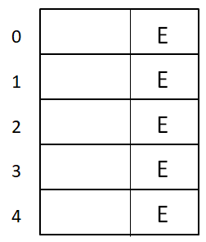
Rehashing Example in Linear Probing
h(key) = key % 5
Insert 12
Insert 22
Insert 25

Slide 32
Additional Resource
Watch this video to understand basic operations of hashing.
  http://y2u.be/KyUTuwz_b7Q

